Slide 1
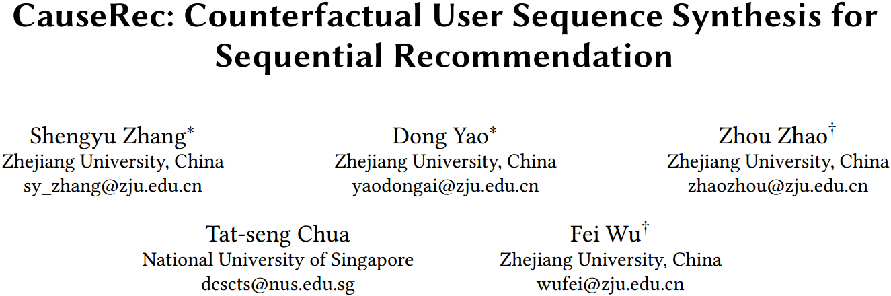

Slide 2
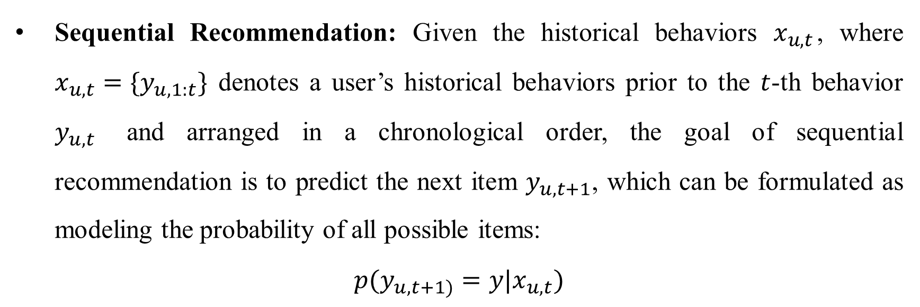
Problem Formulation
Sequential Recommendation: Given the historical behaviors $x_{u,t}$, where $x_{u,t}=\{y_{u,1:t}\}$ denotes a user’s historical behaviors prior to the $t$-th behavior $y_{u,t}$ and arranged in a chronological order, the goal of sequential recommendation is to predict the next item $y_{u,t+1}$, which can be formulated as modeling the probability of all possible items:
$p(y_{u, t+1)}=y|x_{u,t})$

Slide 3
Challenges
Noise of implicit feedback: Due to the ubiquitous distractions that may aﬀect the users’ first impressions, there are inconsistencies between users’ interest and their clicking behaviors, known as the natural noise.
Data sparsity problem: users in general only interact with a limited number of items compared with the item gallery which can easily reach 100 million in large live systems.

Slide 4
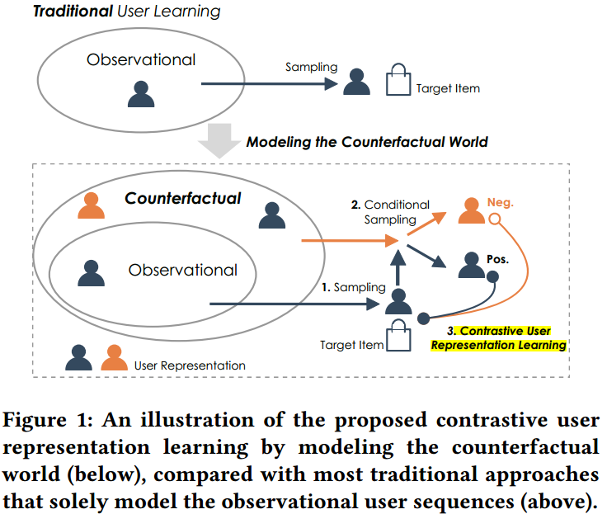
Methodology
Modeling the counterfactual data distribution (besides the observation data distribution) to confront the data sparsity problem.
Devising counterfactual transformations on both fine-grained item-level and abstract interest-level with various contrastive objectives to learn accurate and robust user representations.

Slide 5
Indispensable/Dispensable Concepts
Indispensable concept indicates a subset of one behavior sequence that can jointly represent a meaningful aspect of the user’s interest.
Dispensable concept indicates a noisy subset that is less/meaningful/important in representing an aspect of interest.
Negative user representation: Replacing indispensable concepts in the original user sequence.
Positive user representation: Replacing dispensable concepts in the original user sequence.

Slide 6
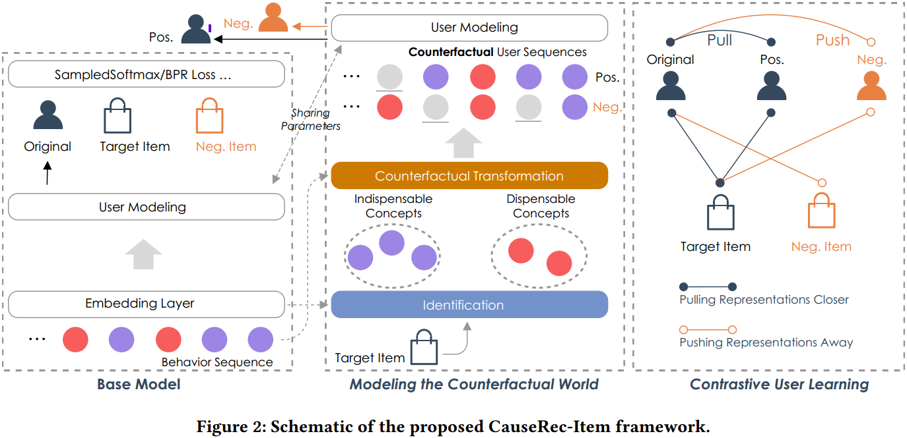
CauserRec

Slide 7
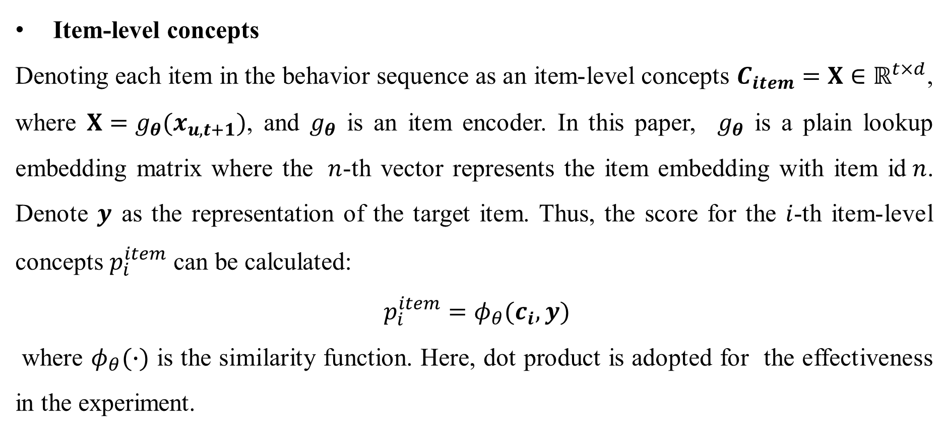
Indispensable/Dispensable Concepts
Item-level concepts
Denoting each item in the behavior sequence as an item-level concepts $C_{item}=X∈ℝ^{t×d}$, where $X=g_{θ}(x_{u,t+1})$, and $g_{θ}$ is an item encoder. In this paper, $g_{θ}$ is a plain lookup embedding matrix where the $n$-th vector represents the item embedding with item id$n$. Denote $y$ as the representation of the target item. Thus, the score for the $i$-th item-level concepts $p_{i}^{item}$ can be calculated:
$p_{i}^{item}=φ_{θ}(c_{i},y)$
where $φ_{θ}(∙)$ is the similarity function. Here, dot product is adopted for the effectiveness in the experiment.

Slide 8
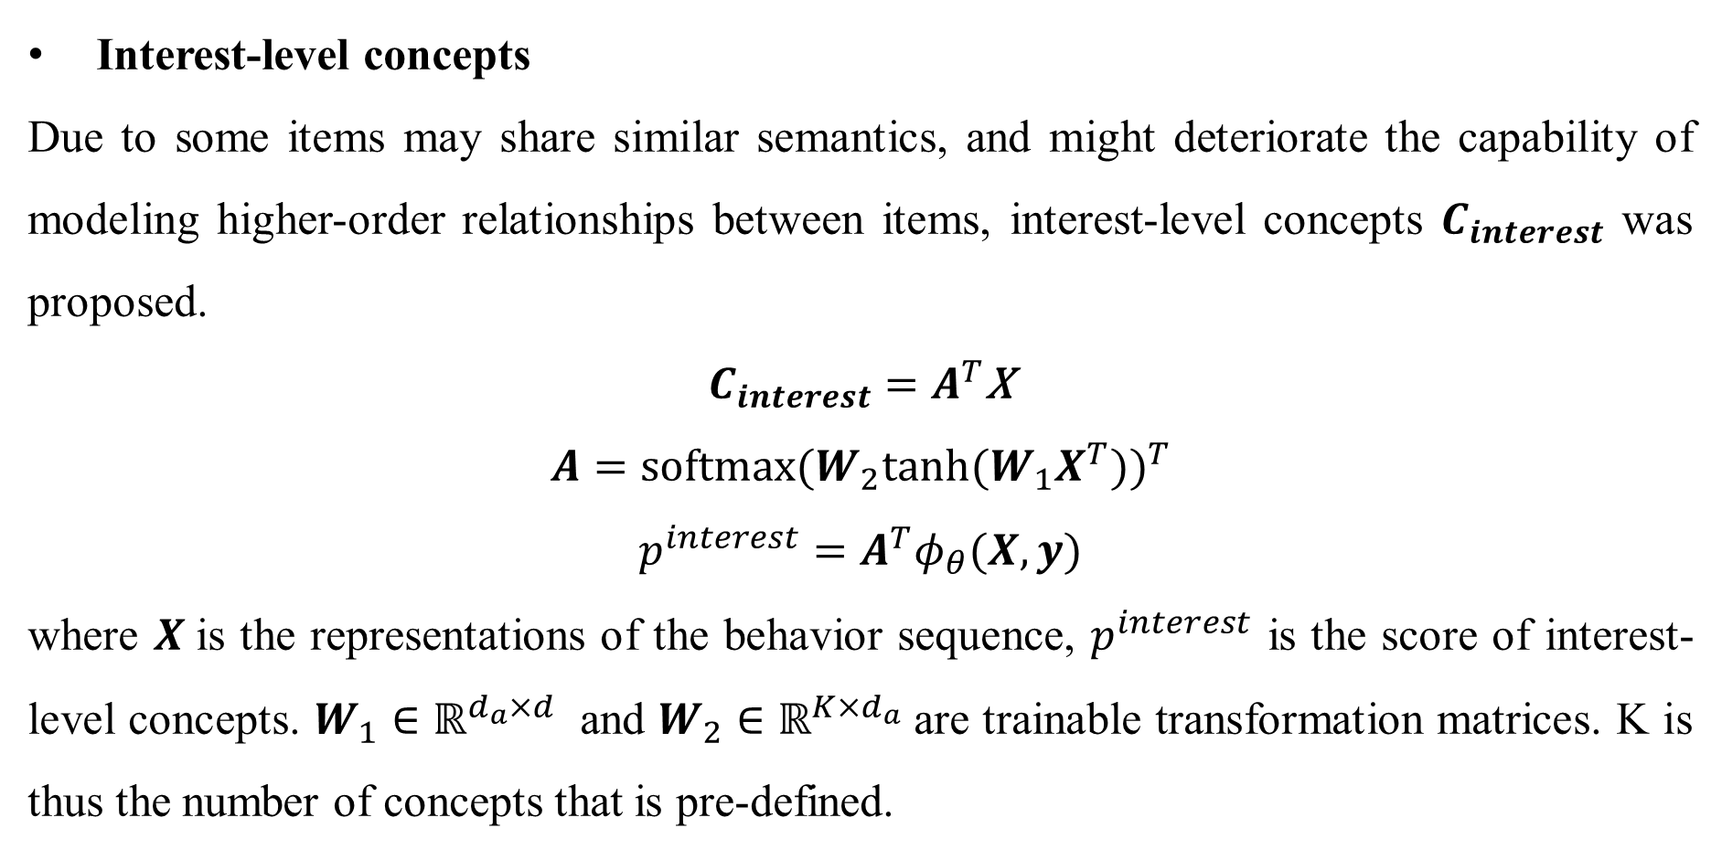
Indispensable/Dispensable Concepts
Interest-level concepts
Due to some items may share similar semantics, and might deteriorate the capability of modeling higher-order relationships between items, interest-level concepts $C_{interest}$ was proposed.
$C_{interest}=$ $A^{T}$X
$$A={\text{softmax}\text{(}W_{2}\text{tanh}\text{(}W_{1}X^{T}\text{))}}^{T}$$
$$p^{interest}=A^{T}φ_{θ}(X,y)$$
where $X$is the representations of the behavior sequence, $p^{interest}$ is the score of interest-level concepts. $W_{1}∈ℝ^{d_{a}×d}$ and $W_{2}∈ℝ^{K×d_{a}}$are trainable transformation matrices. K is thus the number of concepts that is pre-defined.

Slide 9
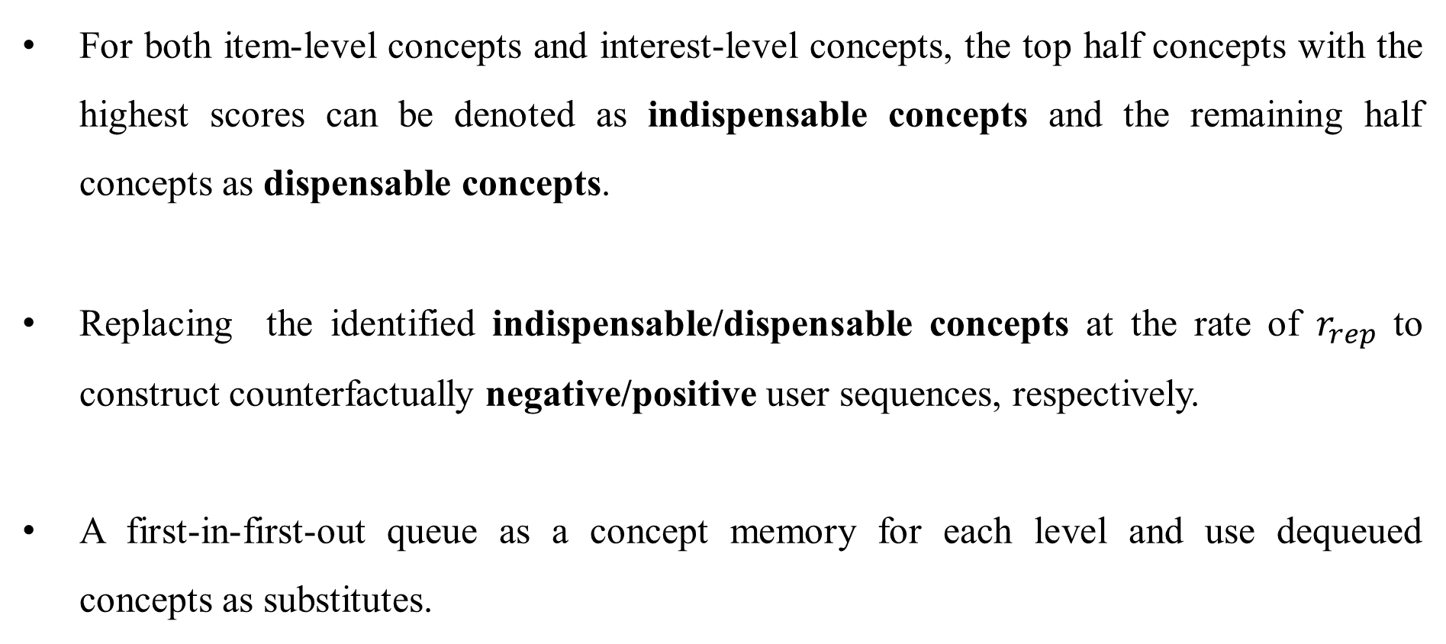
Counterfactual Transformation
For both item-level concepts and interest-level concepts, the top half concepts with the highest scores can be denoted as indispensable concepts and the remaining half concepts as dispensable concepts.
Replacing the identified indispensable/dispensable concepts at the rate of $r_{rep}$ to construct counterfactually negative/positive user sequences, respectively.
A first-in-first-out queue as a concept memory for each level and use dequeued concepts as substitutes.

Slide 10
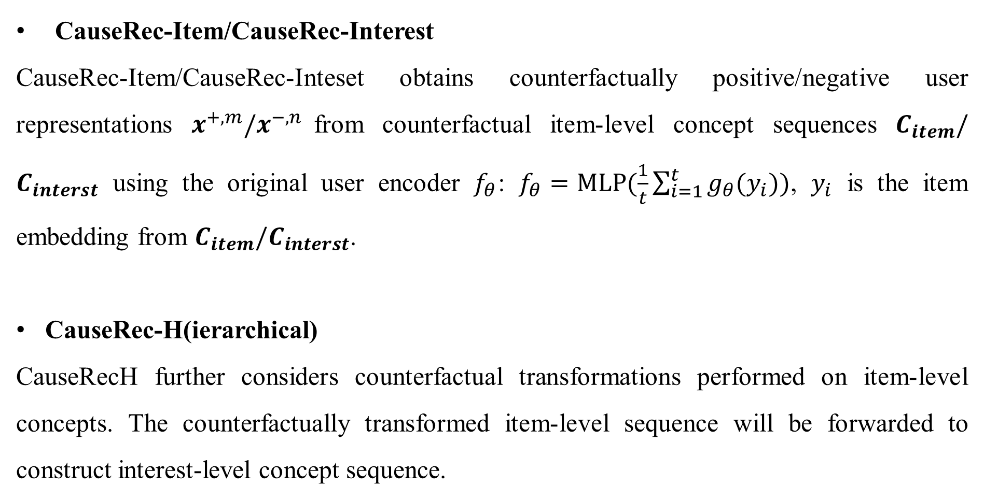
User Encoders
CauseRec-Item/CauseRec-Interest
CauseRec-Item/CauseRec-Inteset obtains counterfactually positive/negative user representations $x^{+,m}/x^{−,n}$from counterfactual item-level concept sequences $C_{item}/C_{interst}$ using the original user encoder $f_{θ}$: $f_{θ}=MLP(\frac{1}{t}\sum_{i=1}^{t}{g_{θ}(y_{i})})$, $y_{i}$ is the item embedding from $C_{item}/C_{interst}$.
CauseRec-H(ierarchical)
CauseRecH further considers counterfactual transformations performed on item-level concepts. The counterfactually transformed item-level sequence will be forwarded to construct interest-level concept sequence.

Slide 11
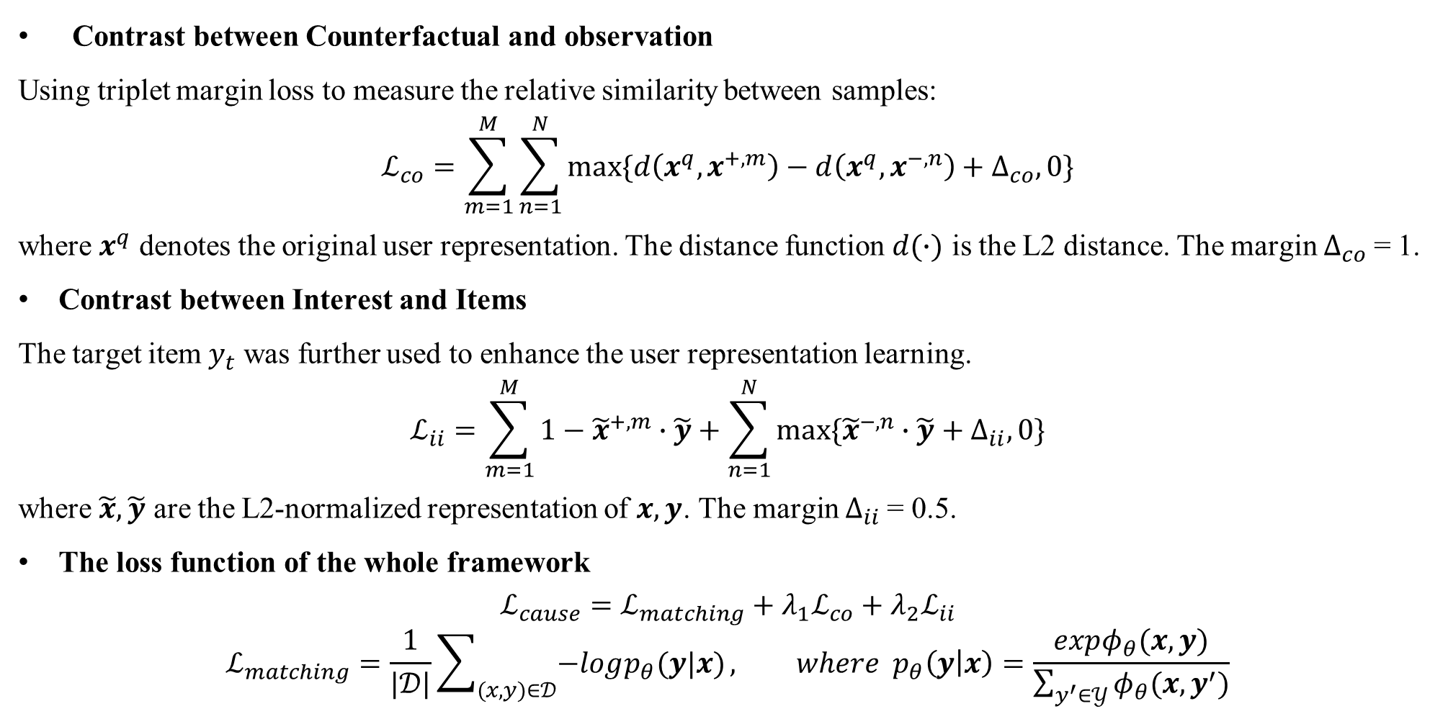
Learning objectives
Contrast between Counterfactual and observation
Using triplet margin loss to measure the relative similarity between samples:
$$ℒ_{co}=\sum_{m=1}^{M}{\sum_{n=1}^{N}{max⁡\{d\left(x^{q},x^{+,m}\right)−d\left(x^{q},x^{−,n}\right)+∆_{co},0\}}}$$
where $x^{q}$ denotes the original user representation. The distance function $d(∙)$ is the L2 distance. The margin $∆_{co}$= 1.
Contrast between Interest and Items
The target item $y_{t}$ was further used to enhance the user representation learning.
$$ℒ_{ii}=\sum_{m=1}^{M}{1−{\tilde{x}}^{+,m}∙\tilde{y}+\sum_{n=1}^{N}{max⁡\{{\tilde{x}}^{−,n}∙\tilde{y}+∆_{ii},0\}}}$$
where $\tilde{x},\tilde{y}$ are the L2-normalized representation of $x,y$. The margin $∆_{ii}$= 0.5.
The loss function of the whole framework
$$ℒ_{cause}=ℒ_{matching}+λ_{1}ℒ_{co}+λ_{2}ℒ_{ii}$$
$$ℒ_{matching}=\frac{1}{|𝒟|}\sum_{(x,y)∈𝒟}{−logp_{θ}(y|x)}, where p_{θ}\left(y | x\right)=\frac{expφ_{θ}(x,y)}{\sum_{y^{′}∈𝒴}{φ_{θ}(x,y^{′})}}$$

Slide 12
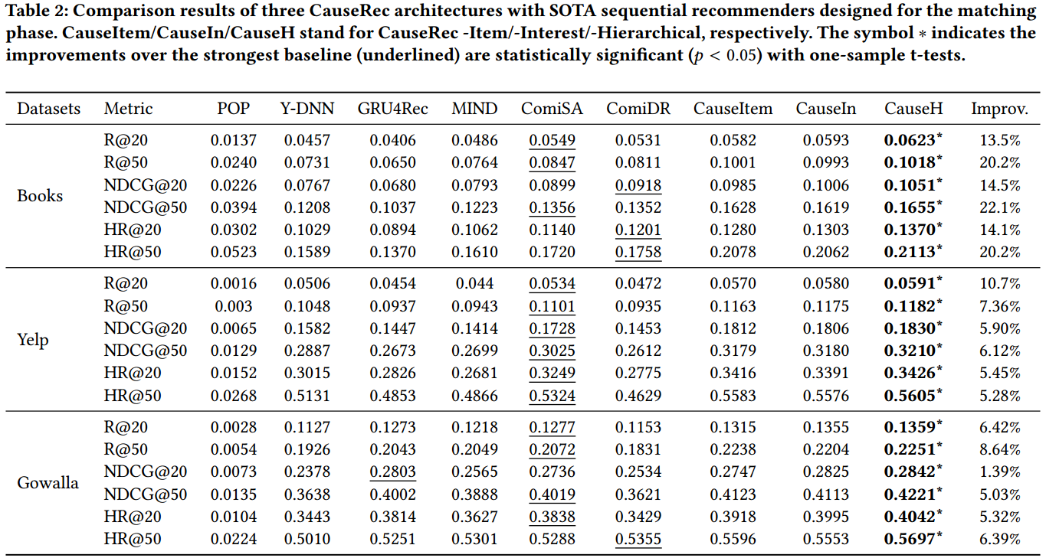
Experiments

Slide 13
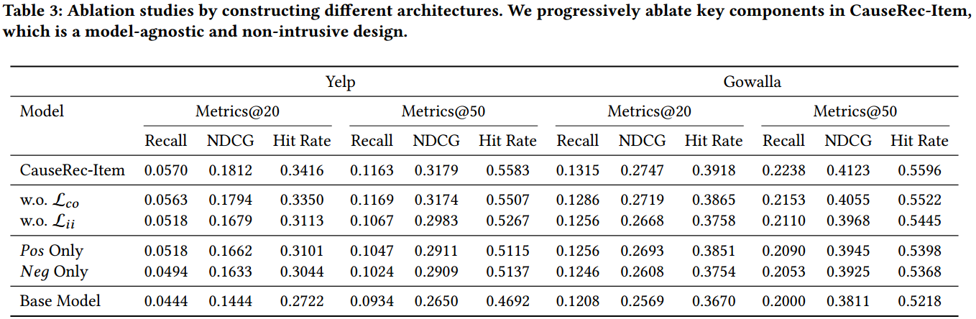
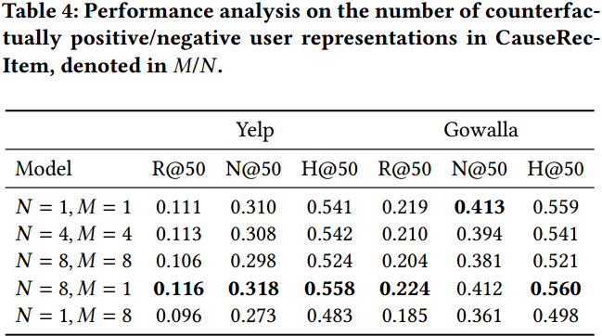
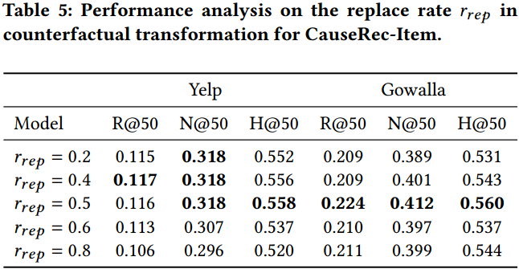
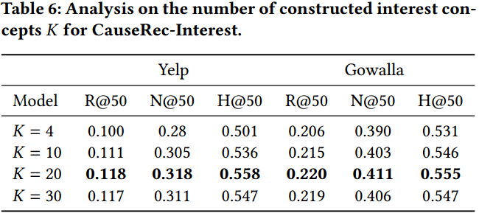
Experiments

